Slide 1
Halo everyone！

Slide 2
How Do Schools Kill Student's Creativity
Chenyang Zhao (from the school of software)
2020/10/22

Slide 3
1
The famous TED talk
Contents
2
Immense diversity with profound impact
3
What or Which
4
What have Middle schools done?
5
Crucial problems come！

Slide 4
The top-watched TED
1

Slide 5


Do schools kill creativity
Education is to produce university professors.
If they are not prepared to be wrong, they can never come up with anything really creative!

Slide 6
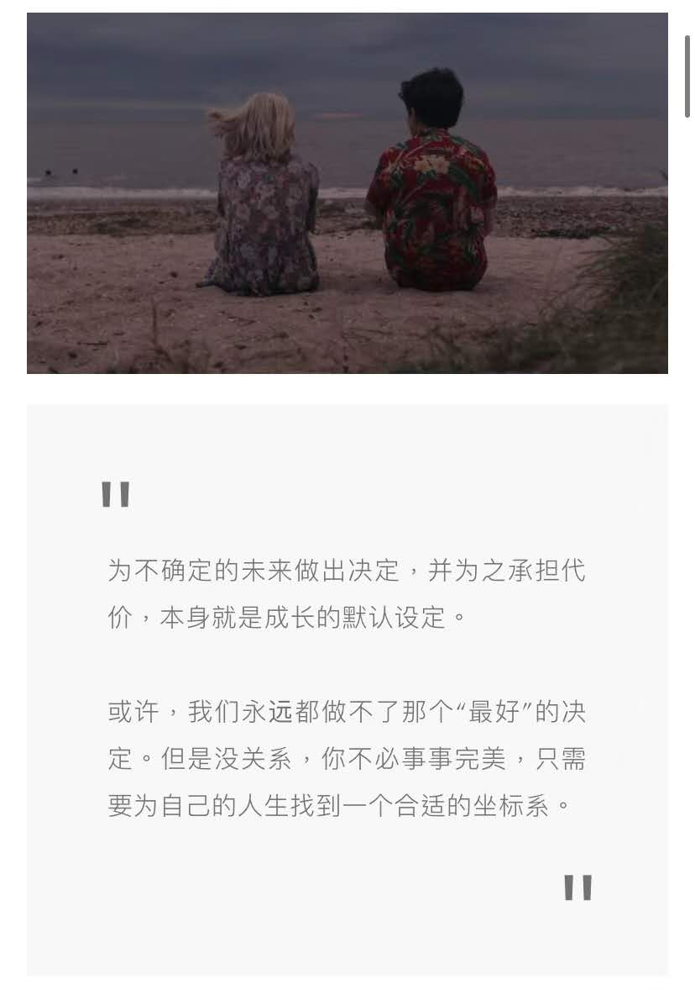

In addition to Sir Robinson's TED
Most of our education deprive us of capacity and courage to make choices by ourselves， but choices have profound impact on our life, thus leading to the lack of creativity.

Slide 7
Immense choices with profound impact
2
in unversity

Slide 8


Immense

Slide 9
We have massive diversity of choices, to which we attach great significance.

Slide 10
To stress this, let's look at some choices you may never have a chance to make in your middle-school life.

Slide 11
what to eat
3.1

Slide 12
What to eat
19 independent dining hall with tasty meals throughout the country.
Even all over the world.

Slide 13
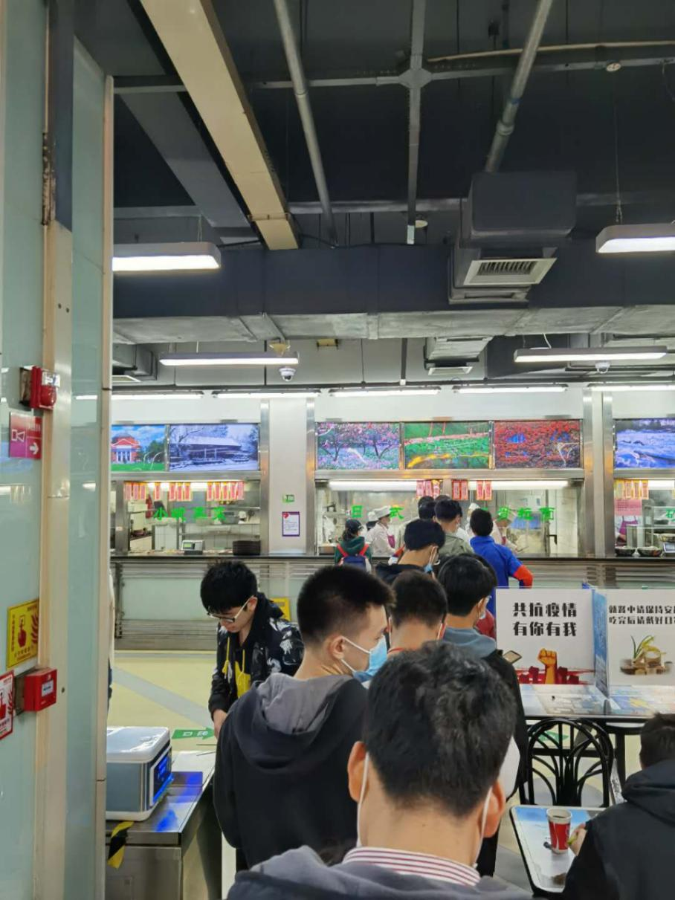


For example
The long queuing line in front of Taoli

Slide 14
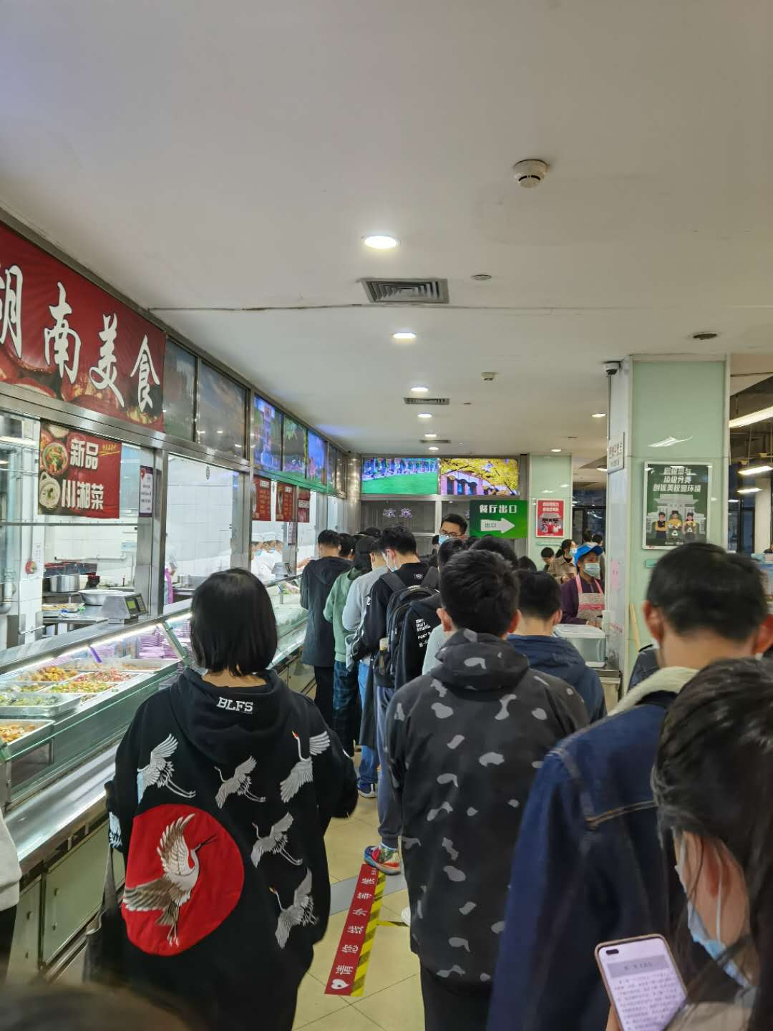

the fourth floor of ZIjing
YYDS !

Slide 15
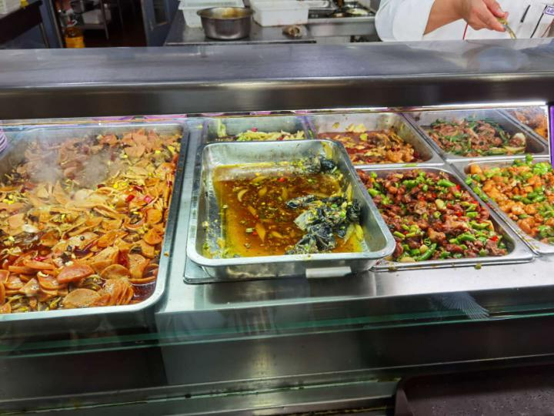

Actually I am suffering.
Where and what to eat?

Slide 16
Which to choose
3.2

Slide 17
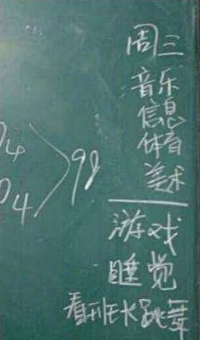
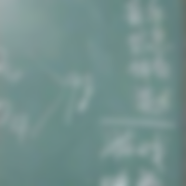
Let's look back.
You may be thinking of this in middle school

Slide 18
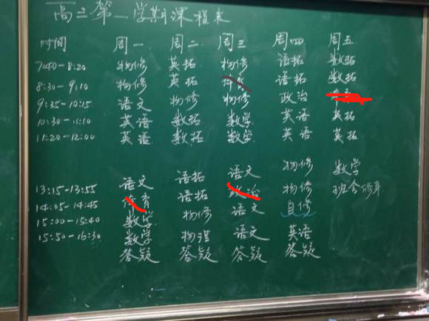
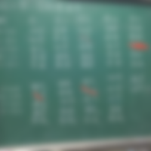
But actually
This is my class table.
NO PE
NO PE
NO PE

Slide 19
But now
We have thousands of courses that we can choose and enjoy
The course you choose now have direct influence on your life equality and happiness degree

Slide 20
For example
If you choose a course like this

Slide 21
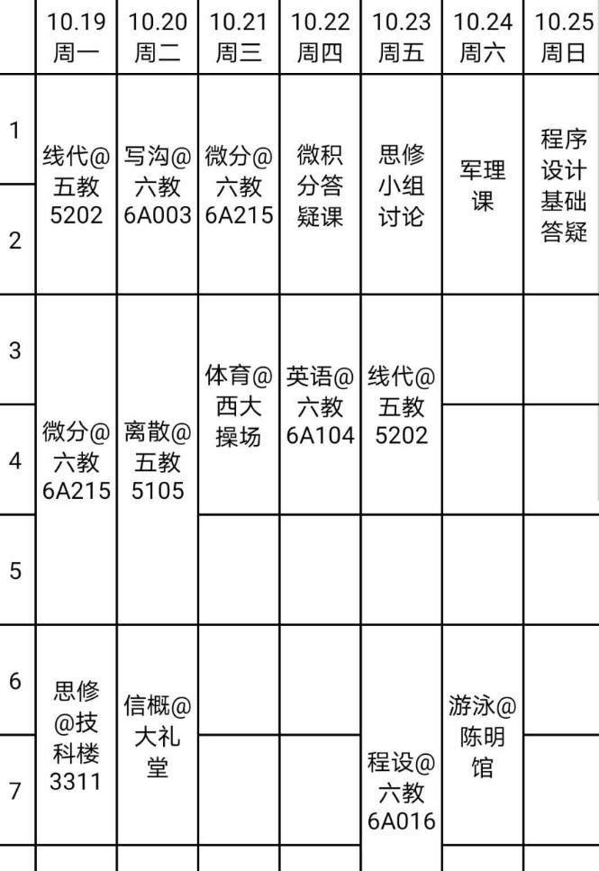

Good good morning 8
day day death

Slide 22
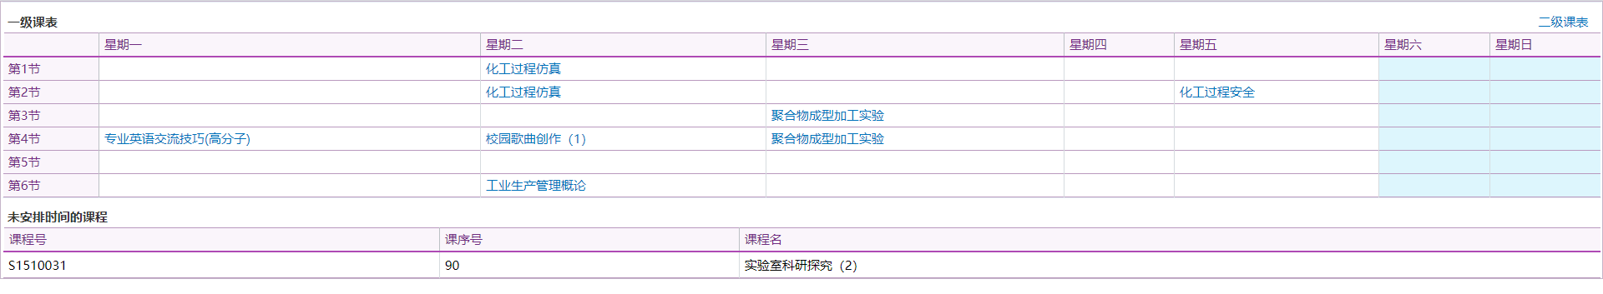

or this
5 courses a week

Slide 23
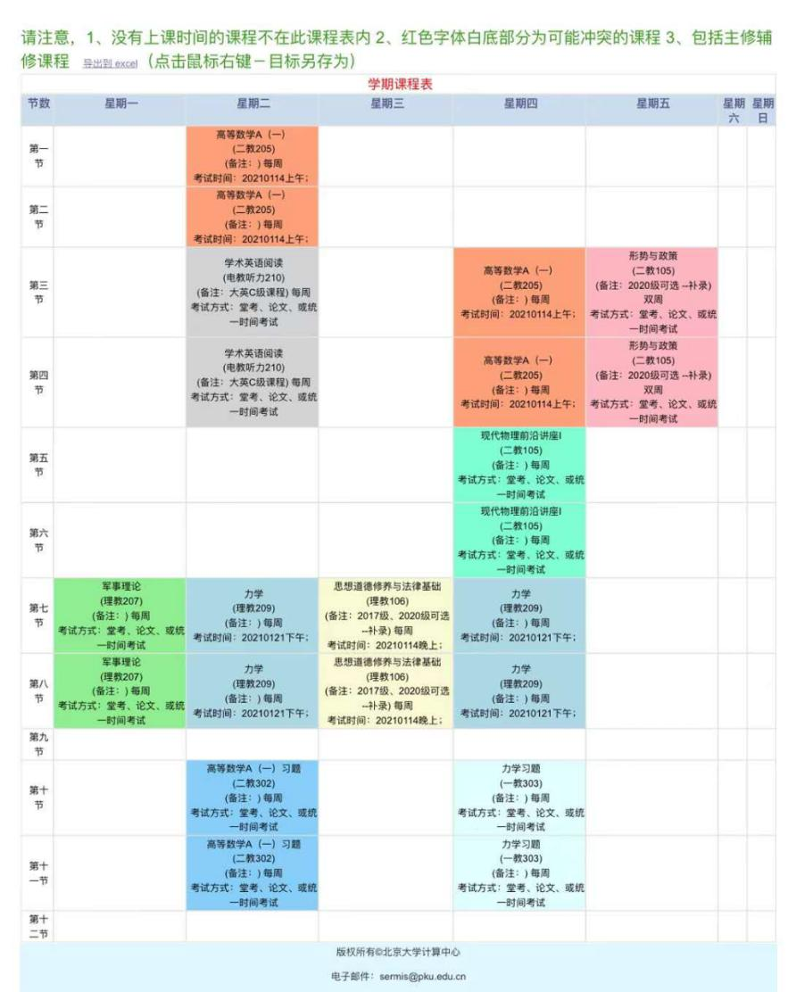
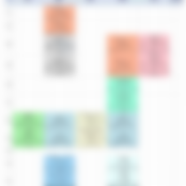
or even this
fatal Tuesday
and killing-life Thursday

Slide 24
What to do
3.3

Slide 25
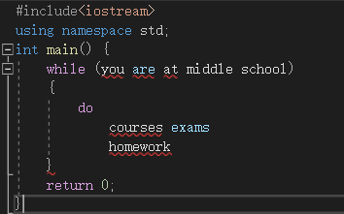
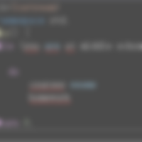
At middle school
courses，exams，homework
Then courses，exams，homework

Slide 26
But Now

Slide 27
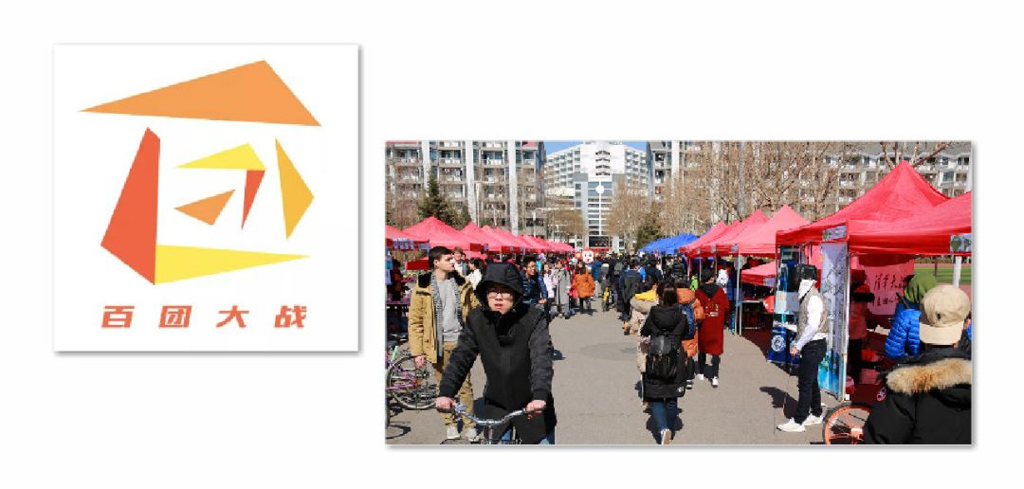

Association community

Slide 28
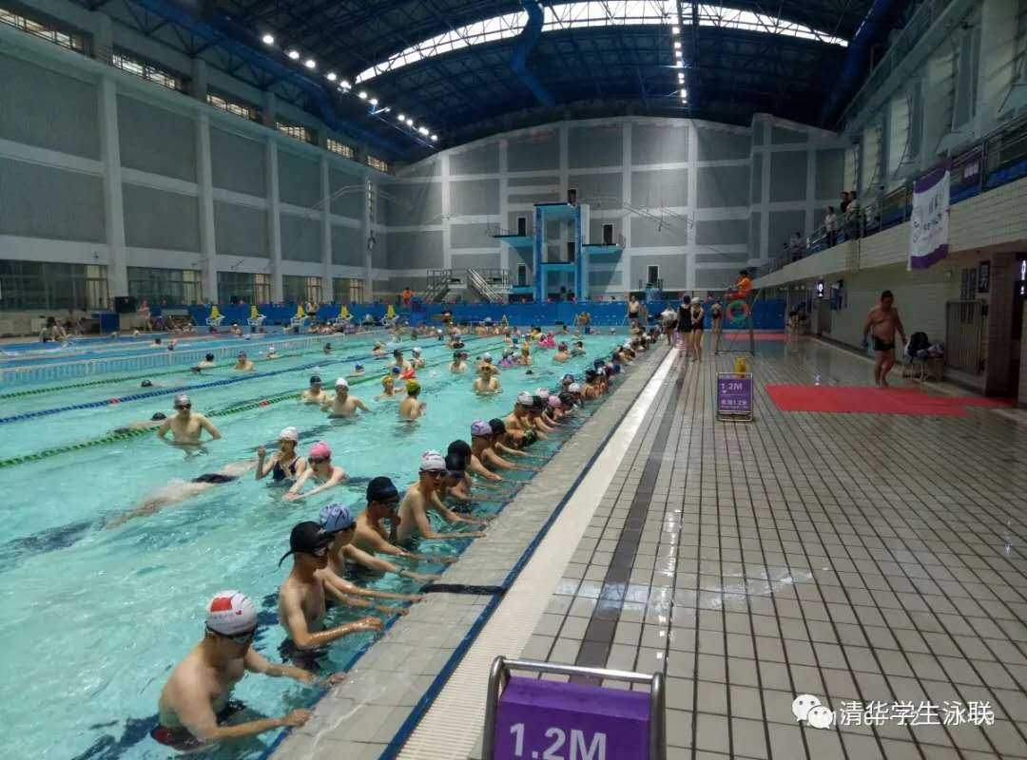

Sports

Slide 29


And this

Slide 30
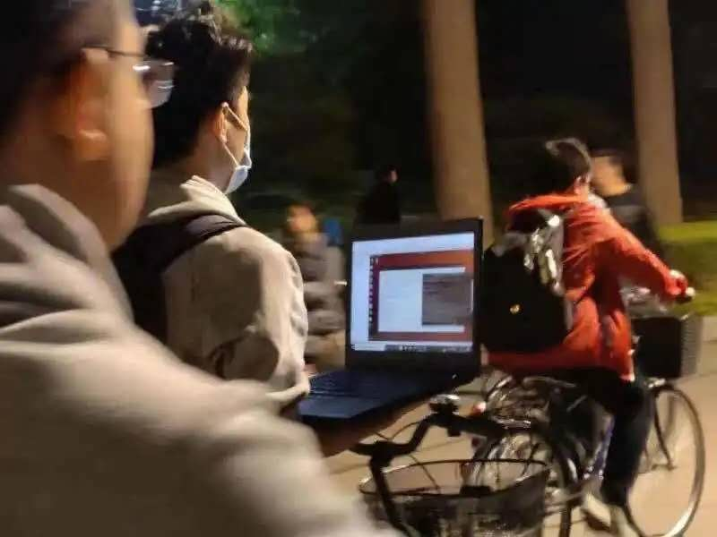
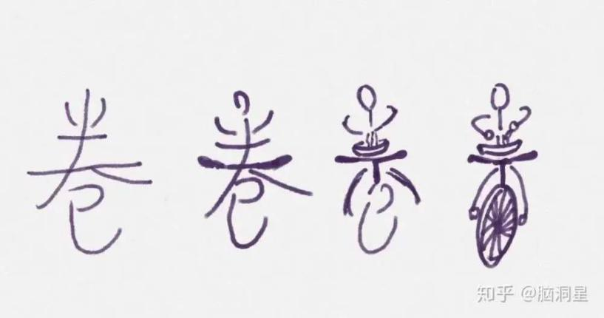


Or even

Slide 31
Choices are charming
But if you do not choose it right.
DDL leads to death.
Lord， I am pondering about what to do and where to go every day.

Slide 32

Conlusion
Massive choice is fairly charming and important，but with unpredictable risk and unbearable price

Slide 33
Now we all have come to realize that university is full of diversity and the capacity for making proper choices is of vital significance.

Slide 34
What have middle schools done?
4

Slide 35
Sir Robinson stressed
In our national education system, mistakes are the worst thing to make.
But if you don't prepare to be wrong, you can hardly come up with something really creative.

Slide 36
Because of the unbearable consequence of making wrong choices
our schools deprive us of nearly all our options which should be carefully chosen and cautiously decided by ourselves.
It made a coercive but vital decision for us.

Slide 37
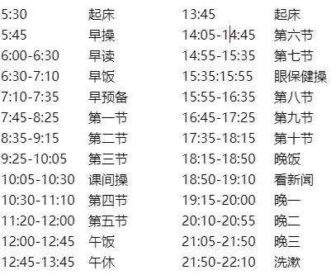

Enroll in a famous middle school
Exert all our time and efforts
Take the college entrance exam

Slide 38
And in the end

Slide 39
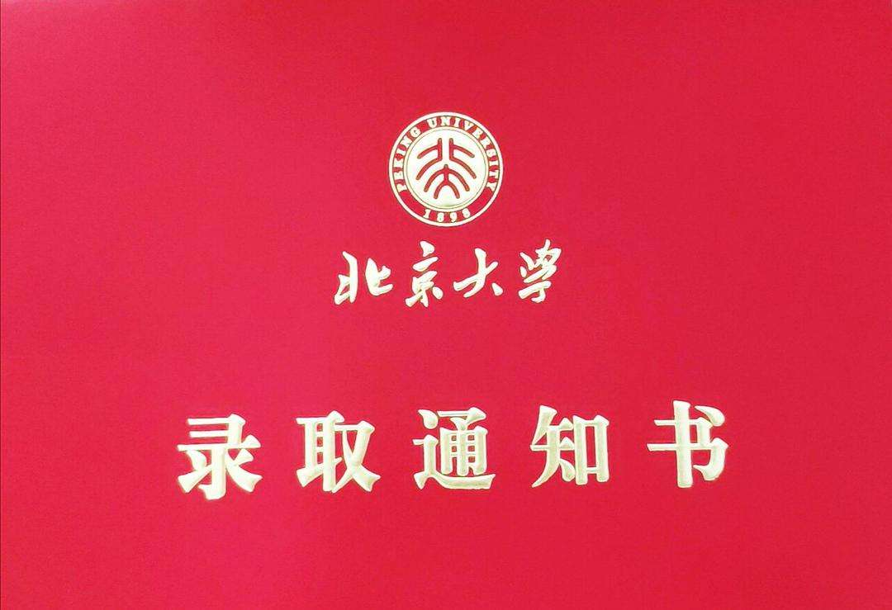


Slide 40
And in the end

Slide 41
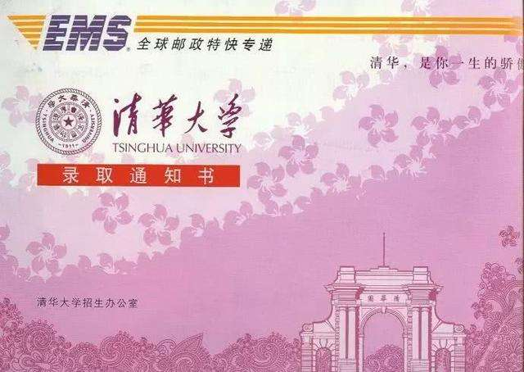


Slide 42
That's fairly a so-called proper choice for nearly all of us.
But every coin have two sides.

Slide 43
Our capacity for making proper choices which are suitable for ourselves most is
JUST DEPRIVED

Slide 44
Sir Robinson said in his TED
Our education is to cater for the most useful subjects for work.

Slide 45
At middle school, we don't have to choose.
We are chosen.
Schools choose these so-called proper choices.
We just fake it as if it is decided by ourselves

Slide 46
Crucial problems come!
4

Slide 47
We are college students right now
Who will make the decisions for ourselves instead of ourselves???

Slide 48
Generalize
Most of our middle school education deprive us of capacity and courage for making decisions by ourselves, which leads to the lack of capacity.

Slide 49
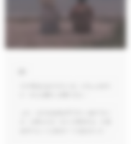
So in the end.
Making decisions for an uncertain future and paying the price for it is itself the default setting for growth.
为不确定的未来做出决定，并为之承担代价，本身就是成长的默认设定。

Slide 50
Thanks

